Slide 1
Finish the desk

Slide 2
Which one is a textbook?

Slide 3
Is math a subject?

Slide 4
Is a rough copy a first draft of a paper?

Slide 5
What is a presentation?

Slide 6
Click on the right NUMBER
What is an essay?

Slide 7
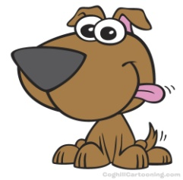
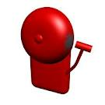
Bell
Which one is the Bell?

Slide 8
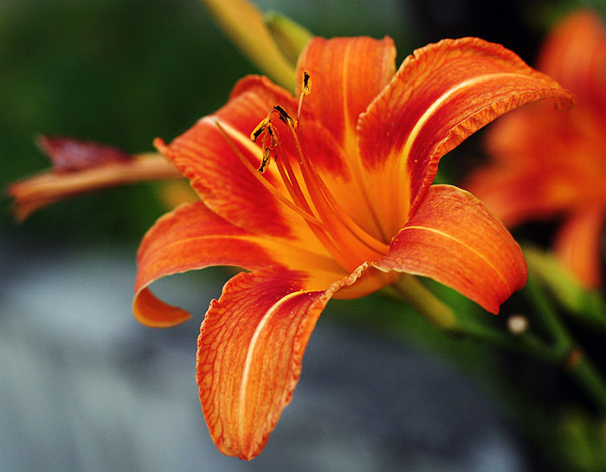
Counselor
Is this a Counselor?

Slide 9
Fire Extinguisher
Which one is the Fire Extinguisher?

Slide 10
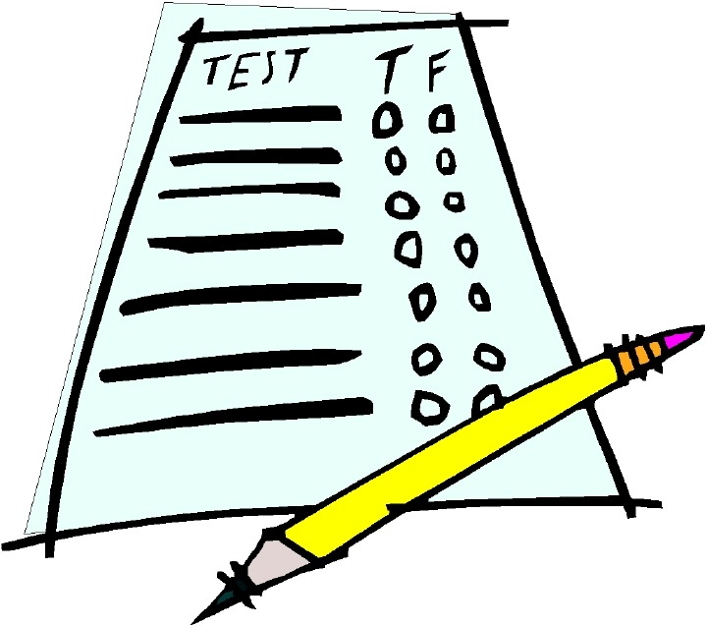
Exam/Test
Is this an exam/test?

Slide 11
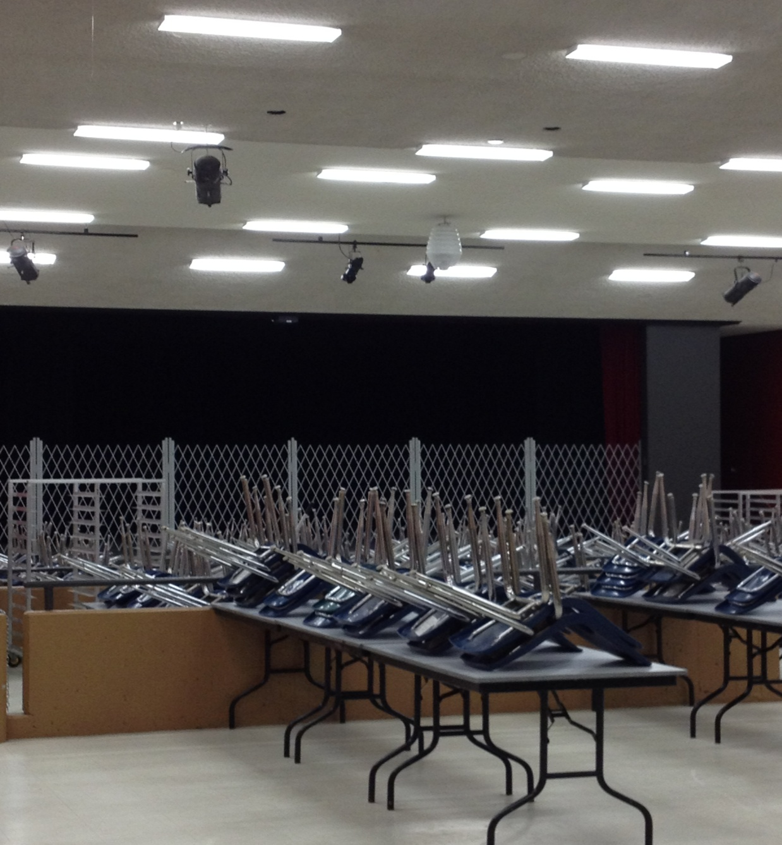
Is this a cafeteria?

Slide 12
Which picture shows track and field?
p
k
g

Slide 13
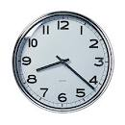
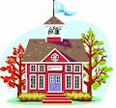
Which one is the General office ?
l
l

Slide 14
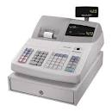
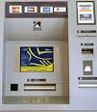
Which picture shows an ATM?
o
p
l

Slide 15
What is the correct spelling…
Summester
Semester
Simester

Slide 16
Do you get a credit when you pass a class?

Slide 17
Is a pass a bad mark on a test?

Slide 18
Finish the F

Slide 19
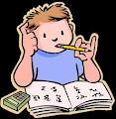
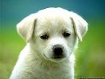
What is homework?
j
j

Slide 20
Is an assignment when you have to do work?

