Slide 1
Vocabulary skills

Slide 2
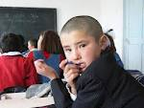
Look at these pictures
Which one is the student?

Slide 3
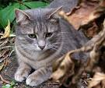
Look at the pictures
Find the degree

Slide 4
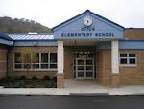
This is a yes or no question
Is this an elementary school?
No

Slide 5
Is this an emergency number? 119

Slide 6
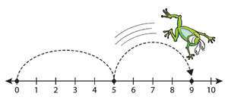
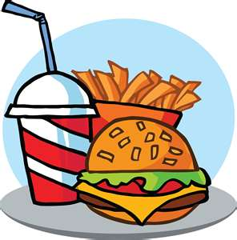
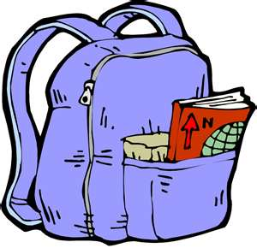
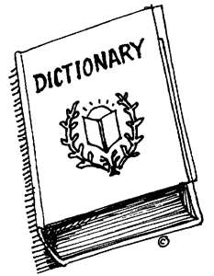
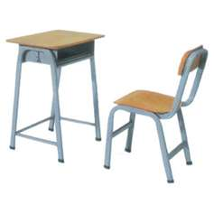
Say these words then match them with the picture
Food
Dictionary
Backpack
Number line
Desk

Slide 7
What is a chalkboard?
This →
Something that you wear as a hat
Something people write on

Slide 8
What picture shows a whiteboard?

Slide 9
What is a screen?
Something that displays picture or information
This →
A type of dance

Slide 10
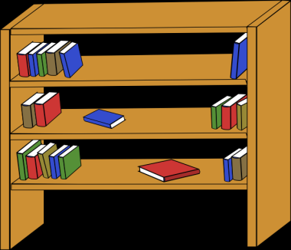
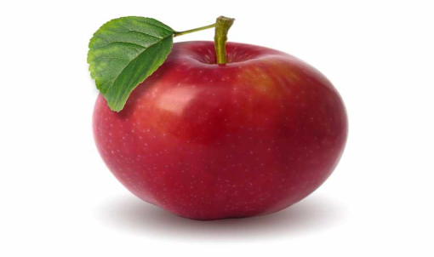
Which shows a bookcase?
This →
This →
This →

Slide 11
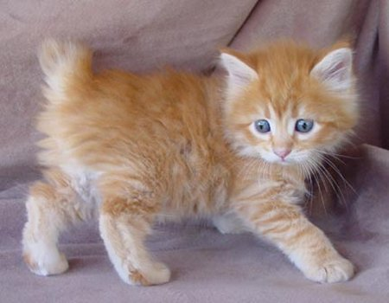
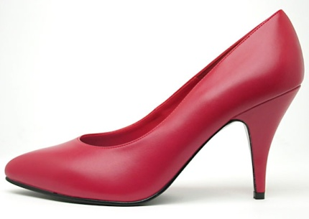
Which picture is a bulletin board?

Slide 12
What is the correct spelling?
Libary
Library
Libeary
Libairy

Slide 13
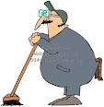
Which one is a Principal?
This one?
This one?
Or this one?

Slide 14
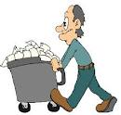
Is this a Custodian?

Slide 15
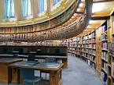
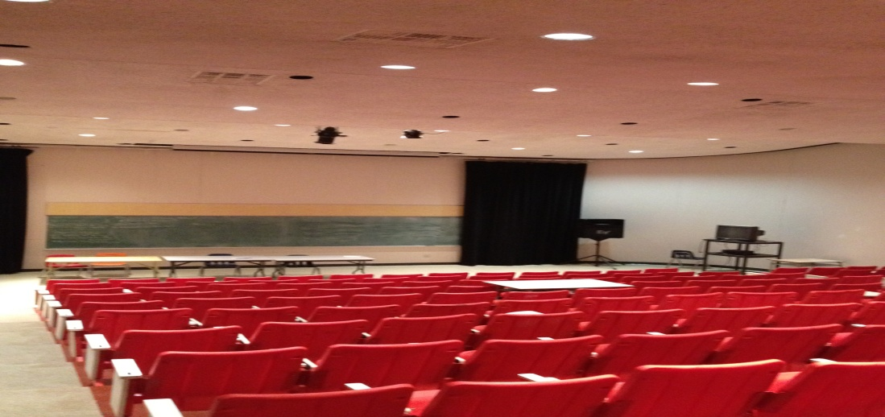
Which one is the auditorium/lecture theatre?
This one?
Or this one?

Slide 16
Is this a Librarian?

Slide 17
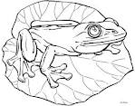
Color the Garbage Can

Slide 18
What is the principal’s helpers name?
helper
president
Vice principal
custodian
student

